Slide 1
Connect Remote Access to HANA
Milind Parab

Slide 2
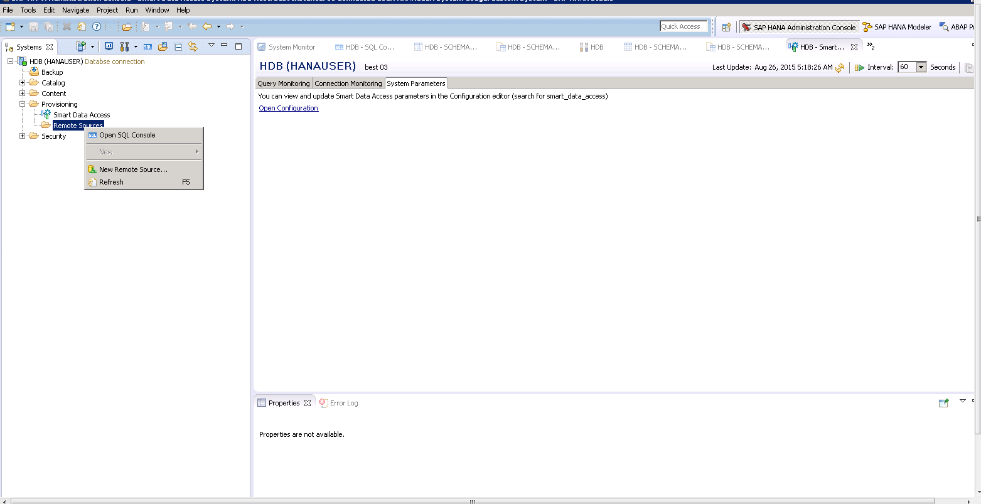
Log on to HANA studio and add a new remote source.

Slide 3
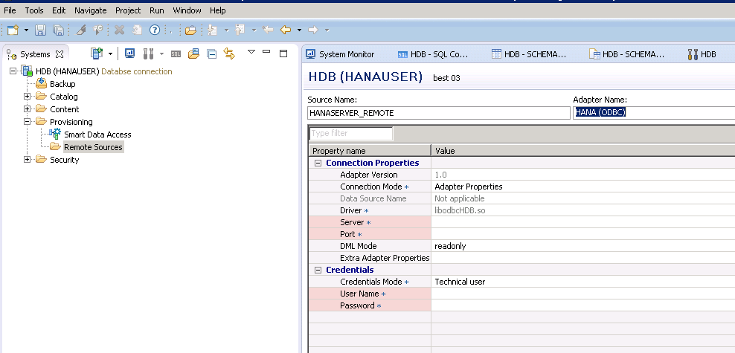
Fill in source name and Adapter Name.

Slide 4
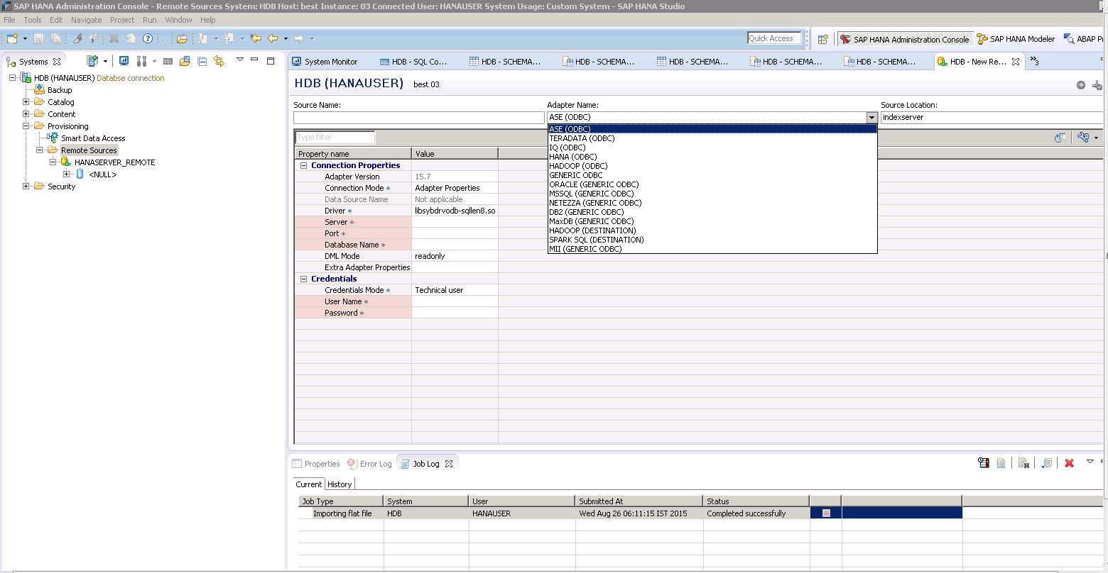
There are many adapters available to connect to.

Slide 5
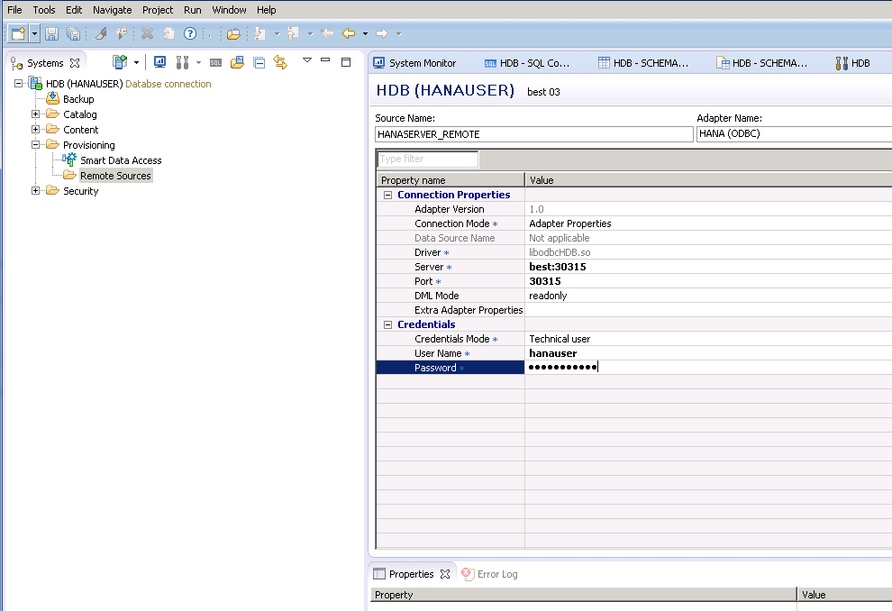
Update Server Name, Port No, Username and Password.

Slide 6
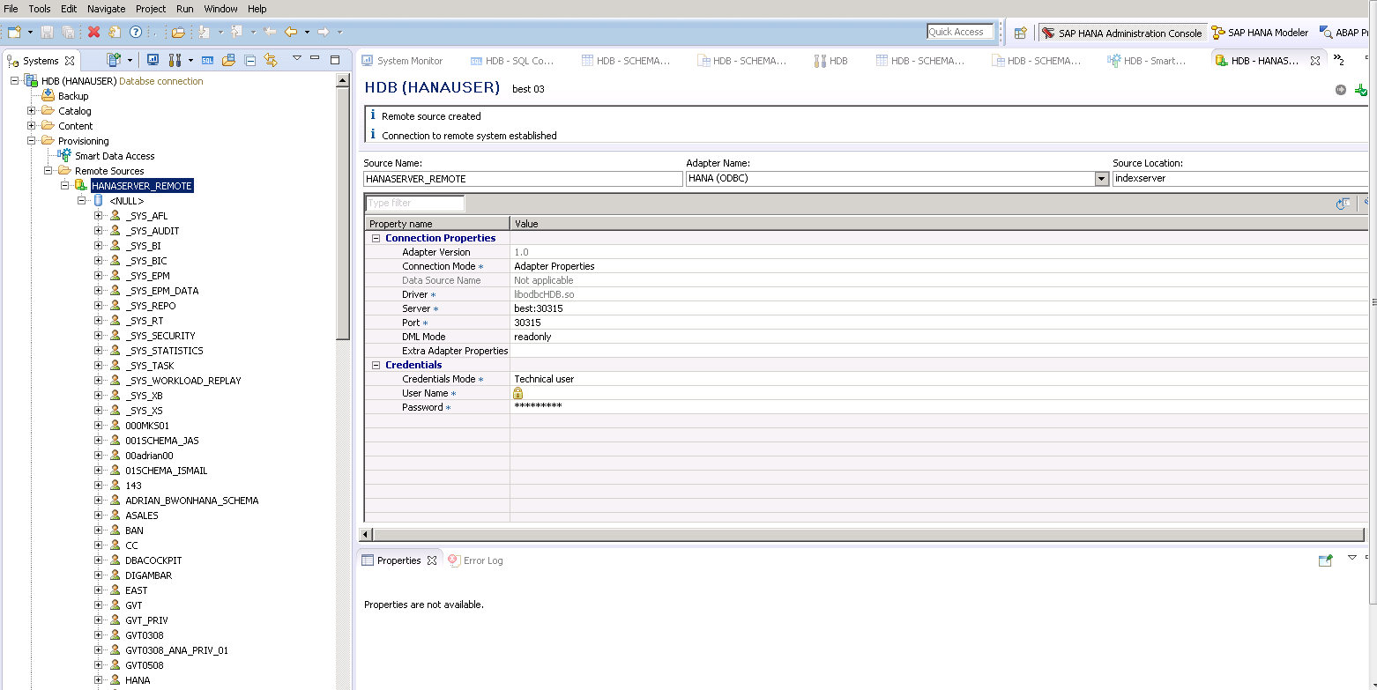
Click on execute.

Slide 7
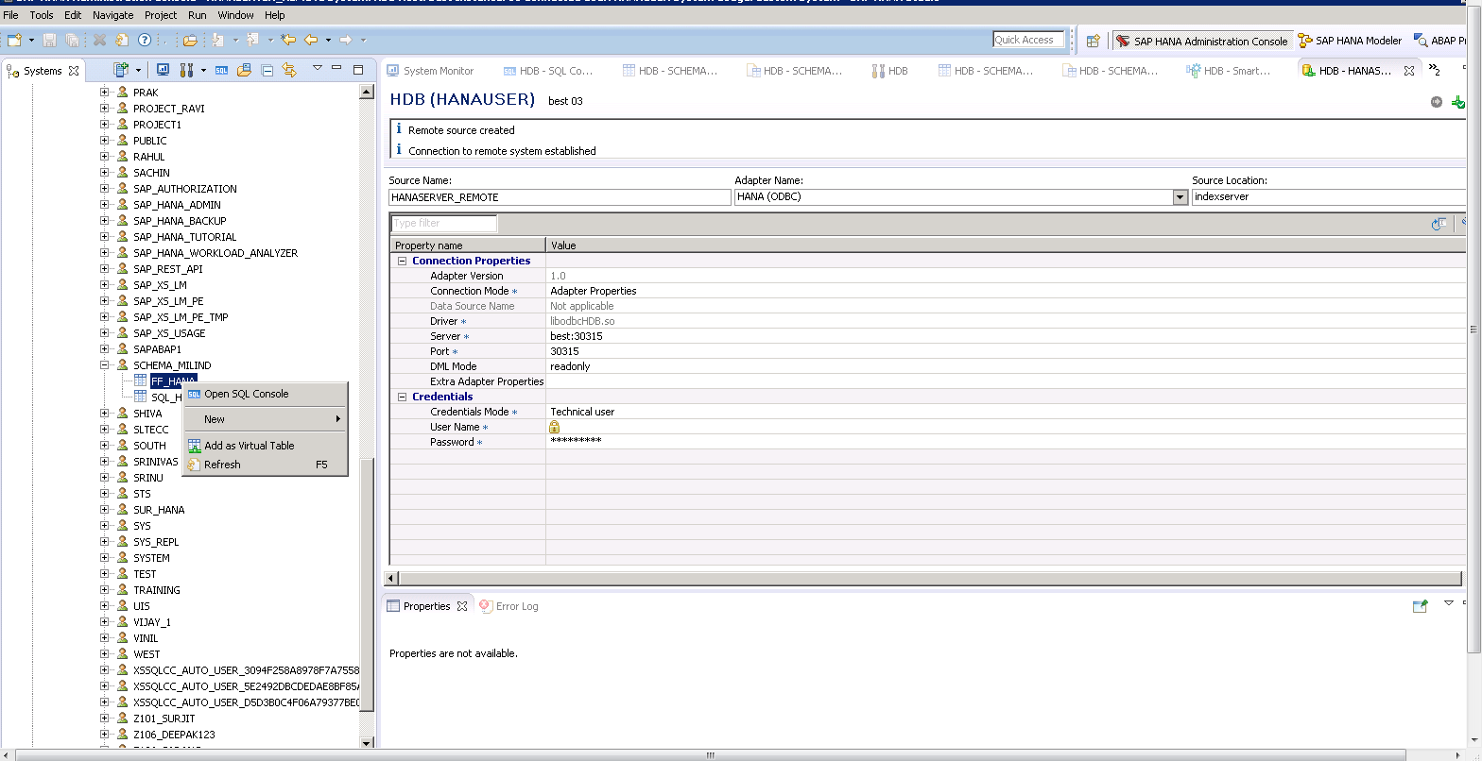
Right click on the table and add as a virtual table.

Slide 8
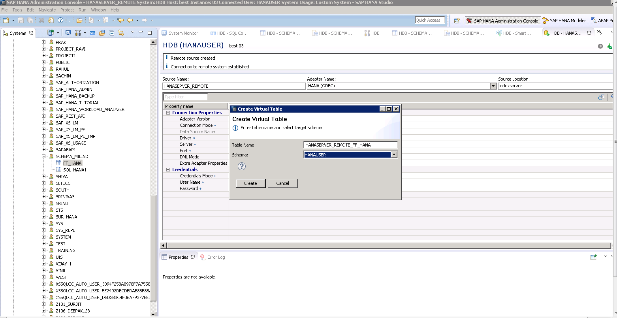
Now, select the schema name.

Slide 9
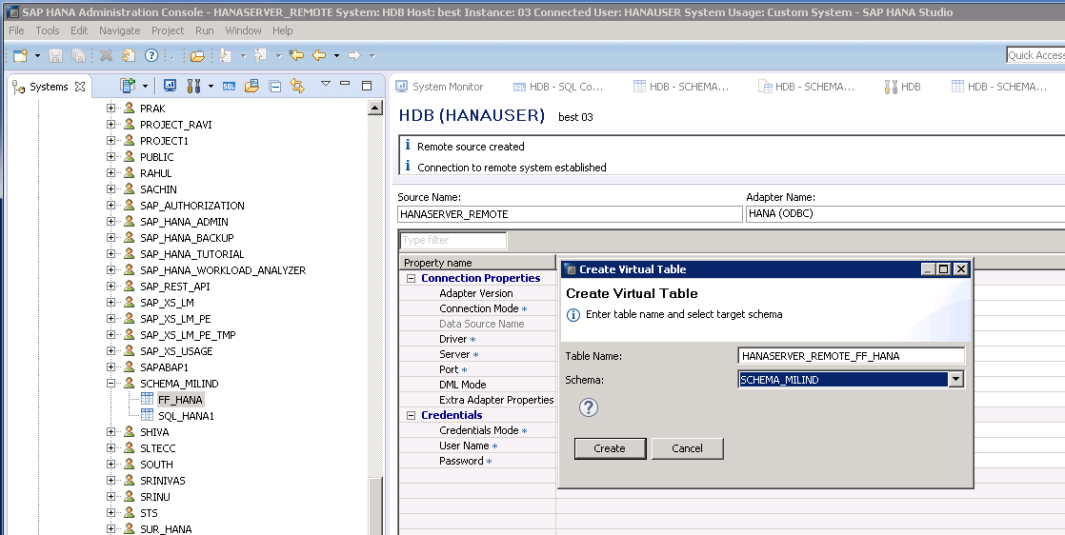
Update Schema and hit create.

Slide 10
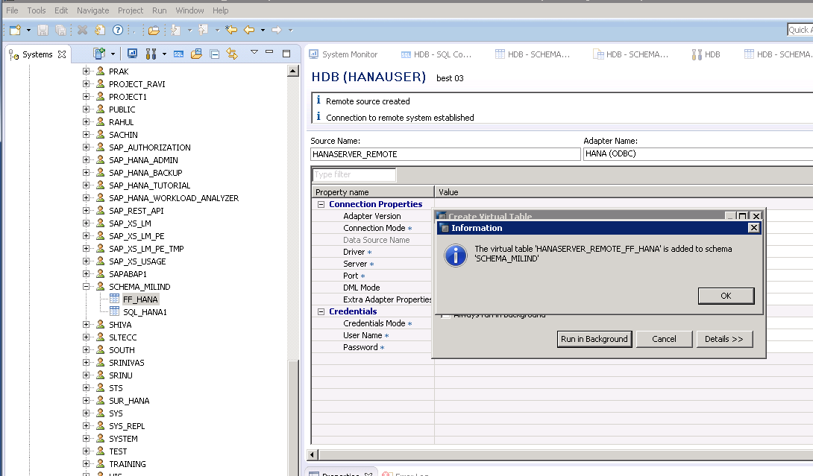
The table has been created successfully.

Slide 11
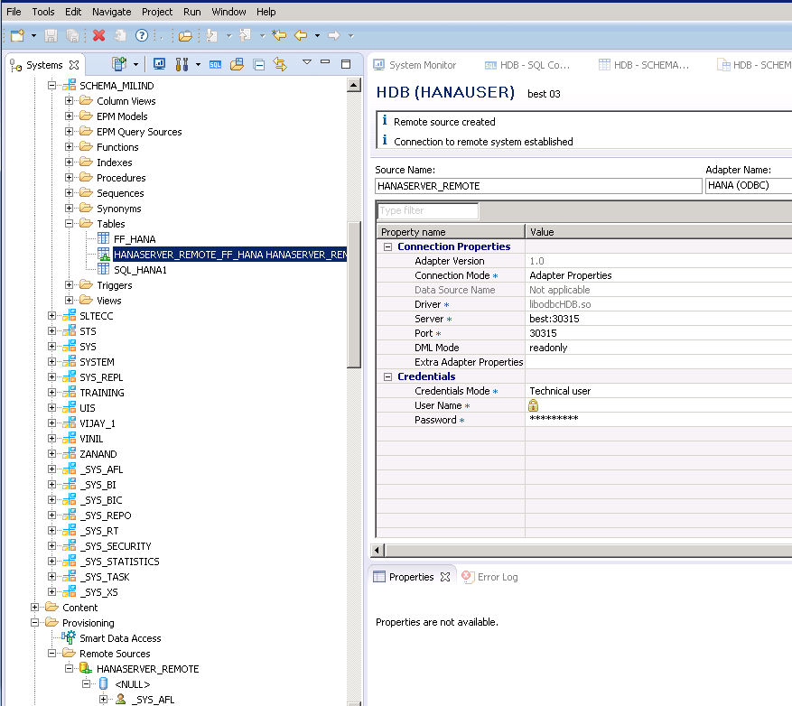
If you check the schema the table has been created successfully.

Slide 12
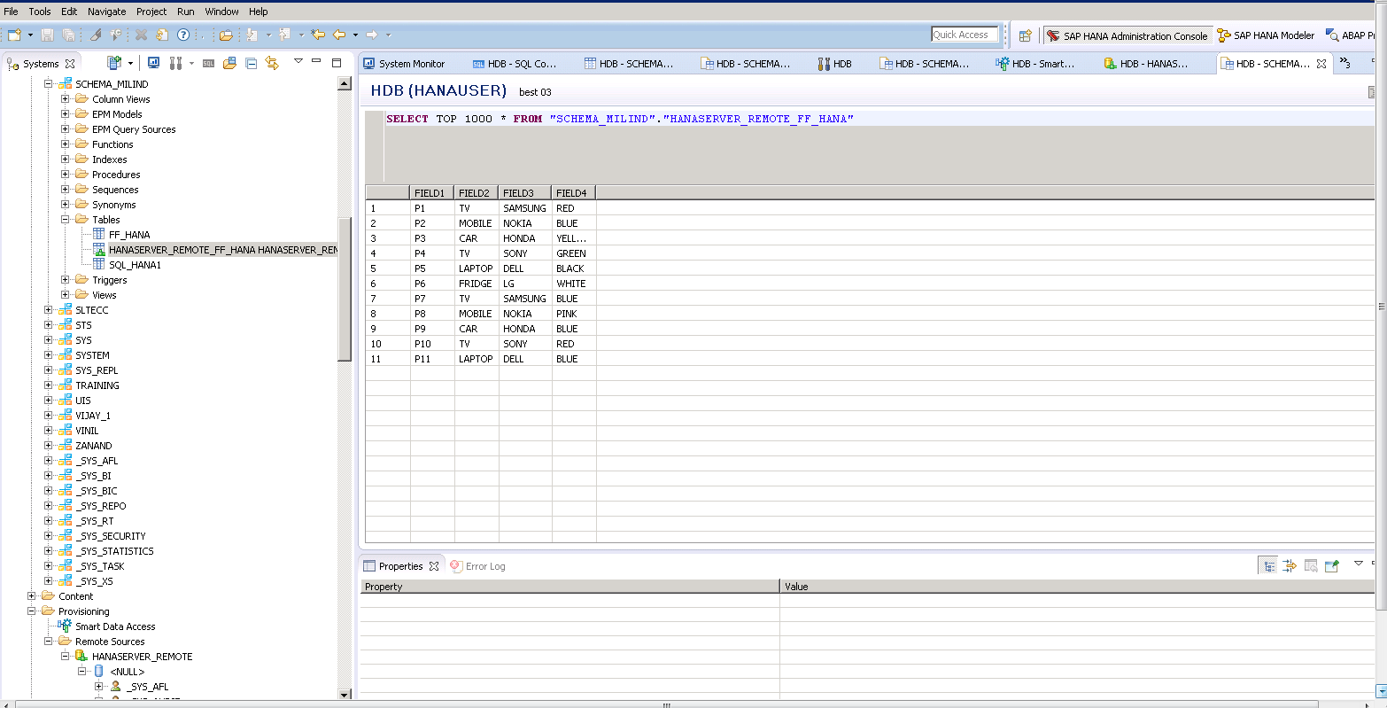
Cont.

Slide 13
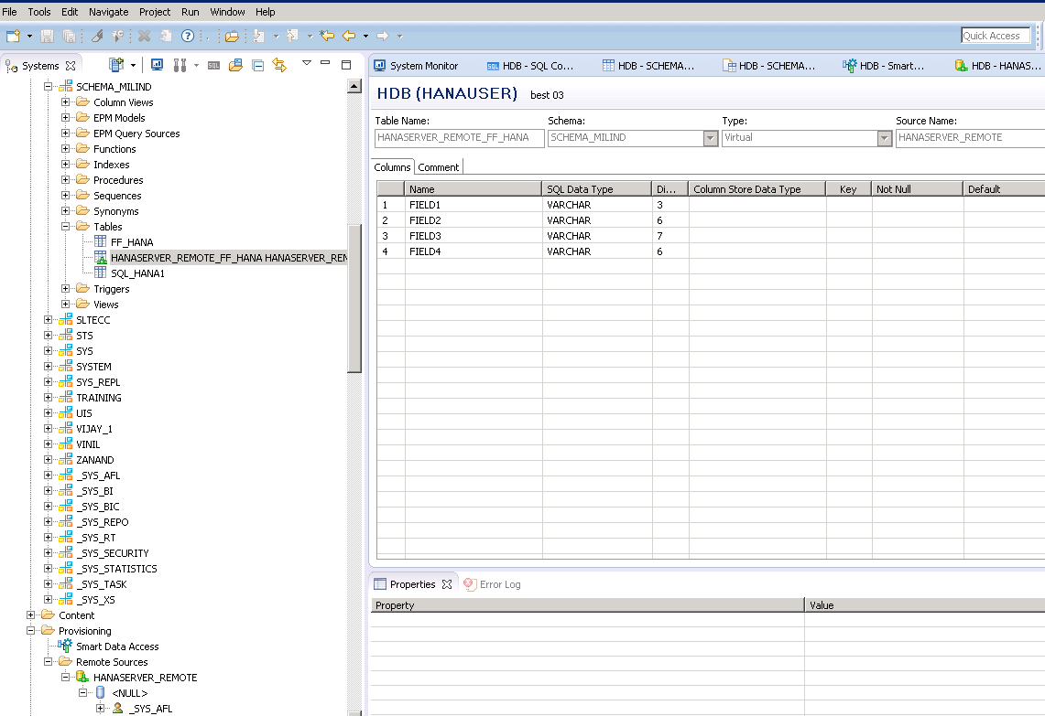
If you check the table type, it is vitual.

